Slide 1

Physical Activity and Build Environment in the County of Hawaii
Infrastructure Solutions

Slide 2
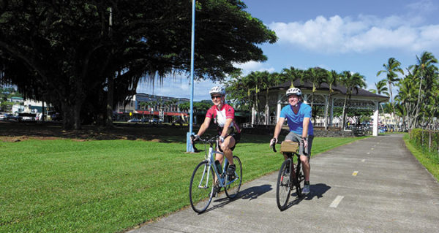
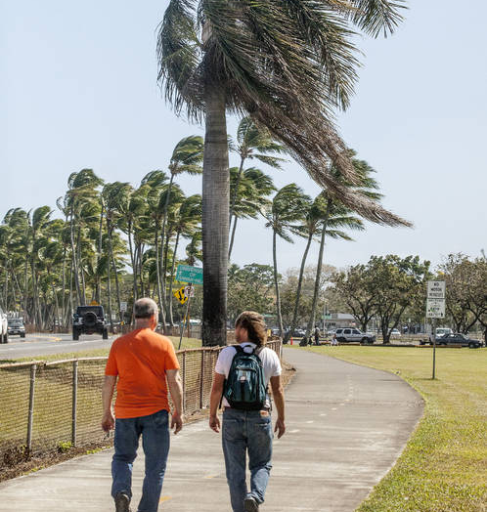
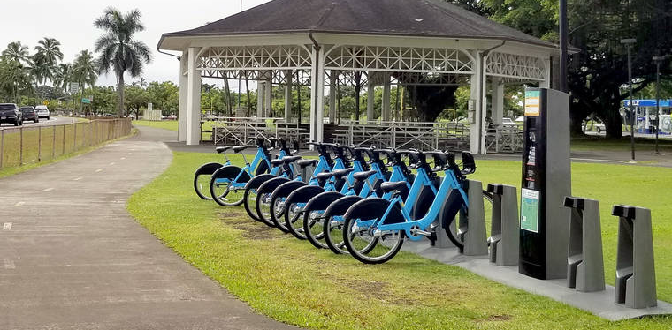
Bike and Pedestrian Facilities
Pan 06 - Increase by 50 miles, the total miles of low-stress pedestrian infrastructure including, but not limited to, sidewalks and trails.
Pan 07 - Increase by 100 miles, the total miles of low-stress bicycle infrastructure including, but not limited to, protected bike lanes and off-street paths.

Slide 3
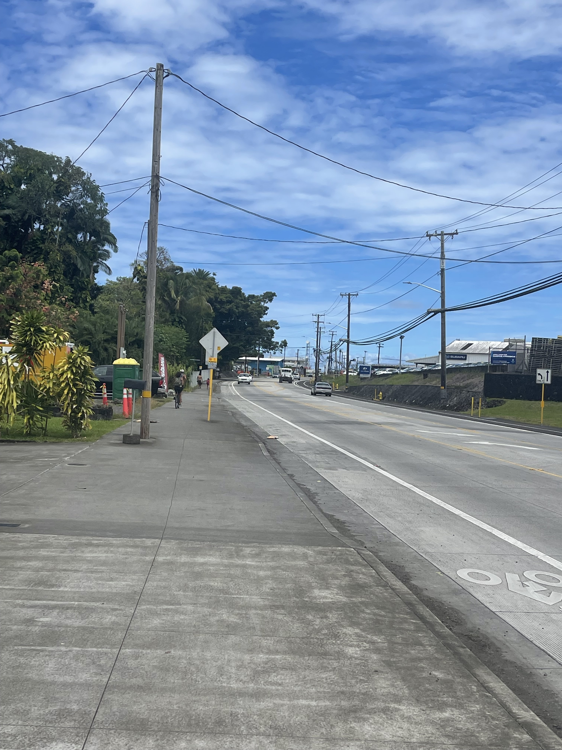
Recently Completed
Kalanianaole Ave.
Work included roadway widening to include buffered bike lanes and double turn. The is large amount of heavy vehicles that travel through are from Hilo Harbor and adjacent industrial land uses.
Road to Keaukaha
Large sidewalk on makai side offers pedestrian facility and accommodates biker of every ability.​

Slide 4
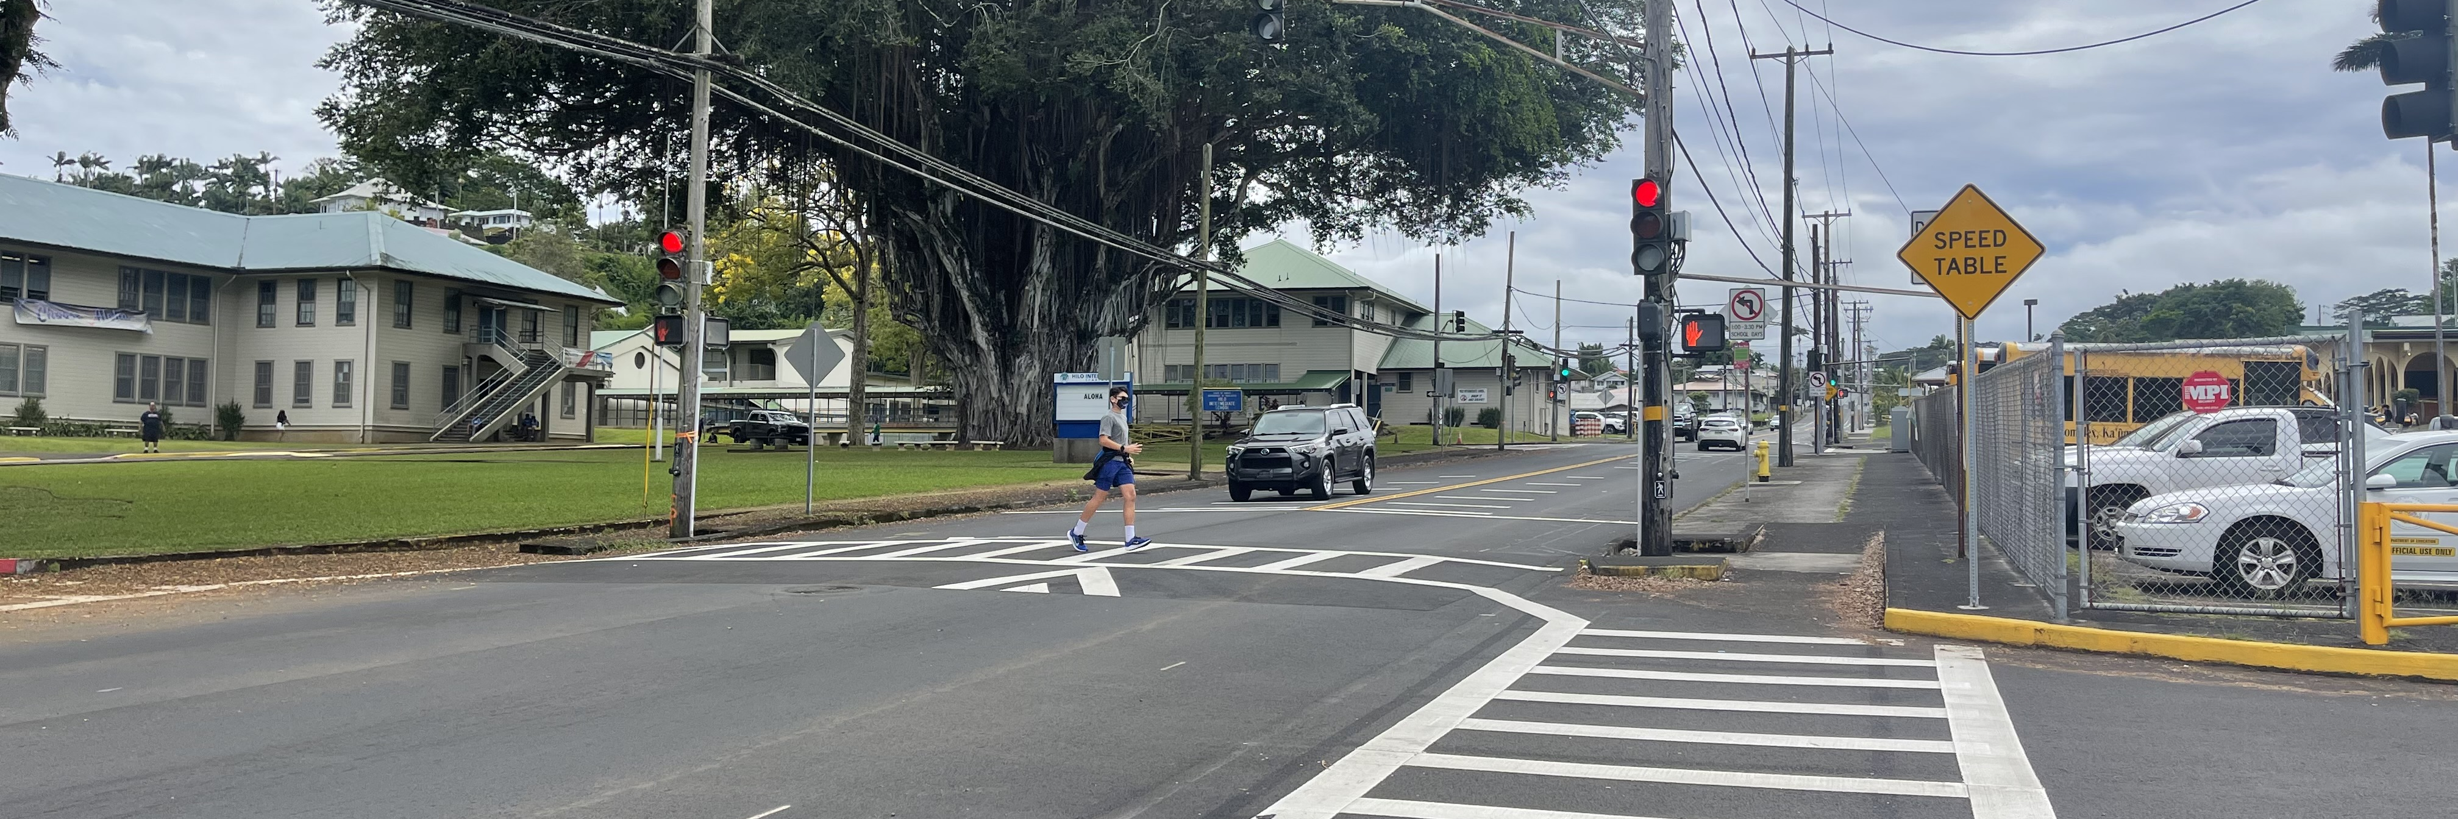
Waianuenue Ave
Pavement Rehabilitation project that added speed tables to reduce speeding around Hilo Intermediate and High School​
​

Slide 5
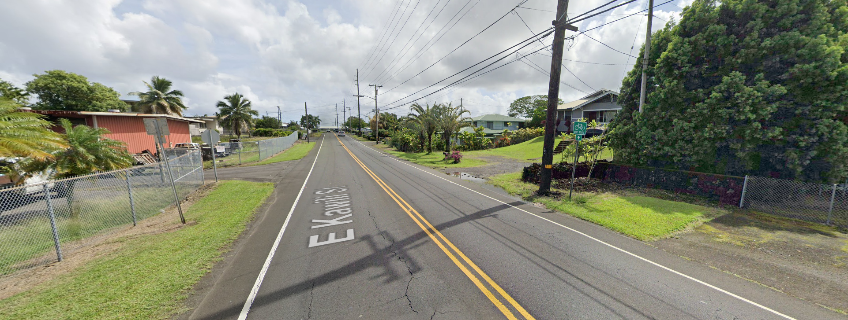
East Kawaili Street
Connects UH Hilo to Hawaii Community College. Construction to start by the end of the year to improve and widen shoulders for bike lanes and pedestrian use

Slide 6
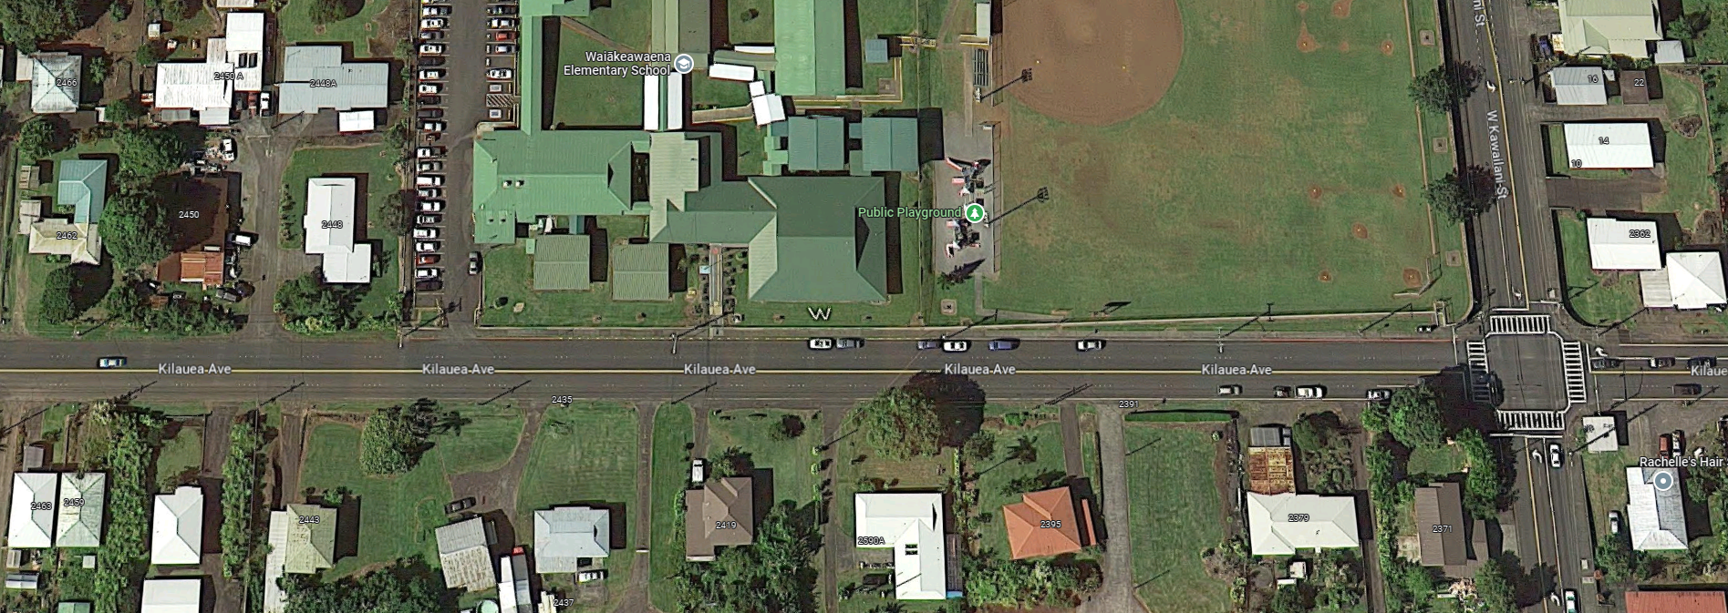
Kilauea Ave – Haiahi St to Puainako St
Project in design to add shoulders possibly add side walks for bike and pedestrian use. Currently the roadway has no paved shoulder and consist of if 3-4 lanes of travelway.

Slide 7
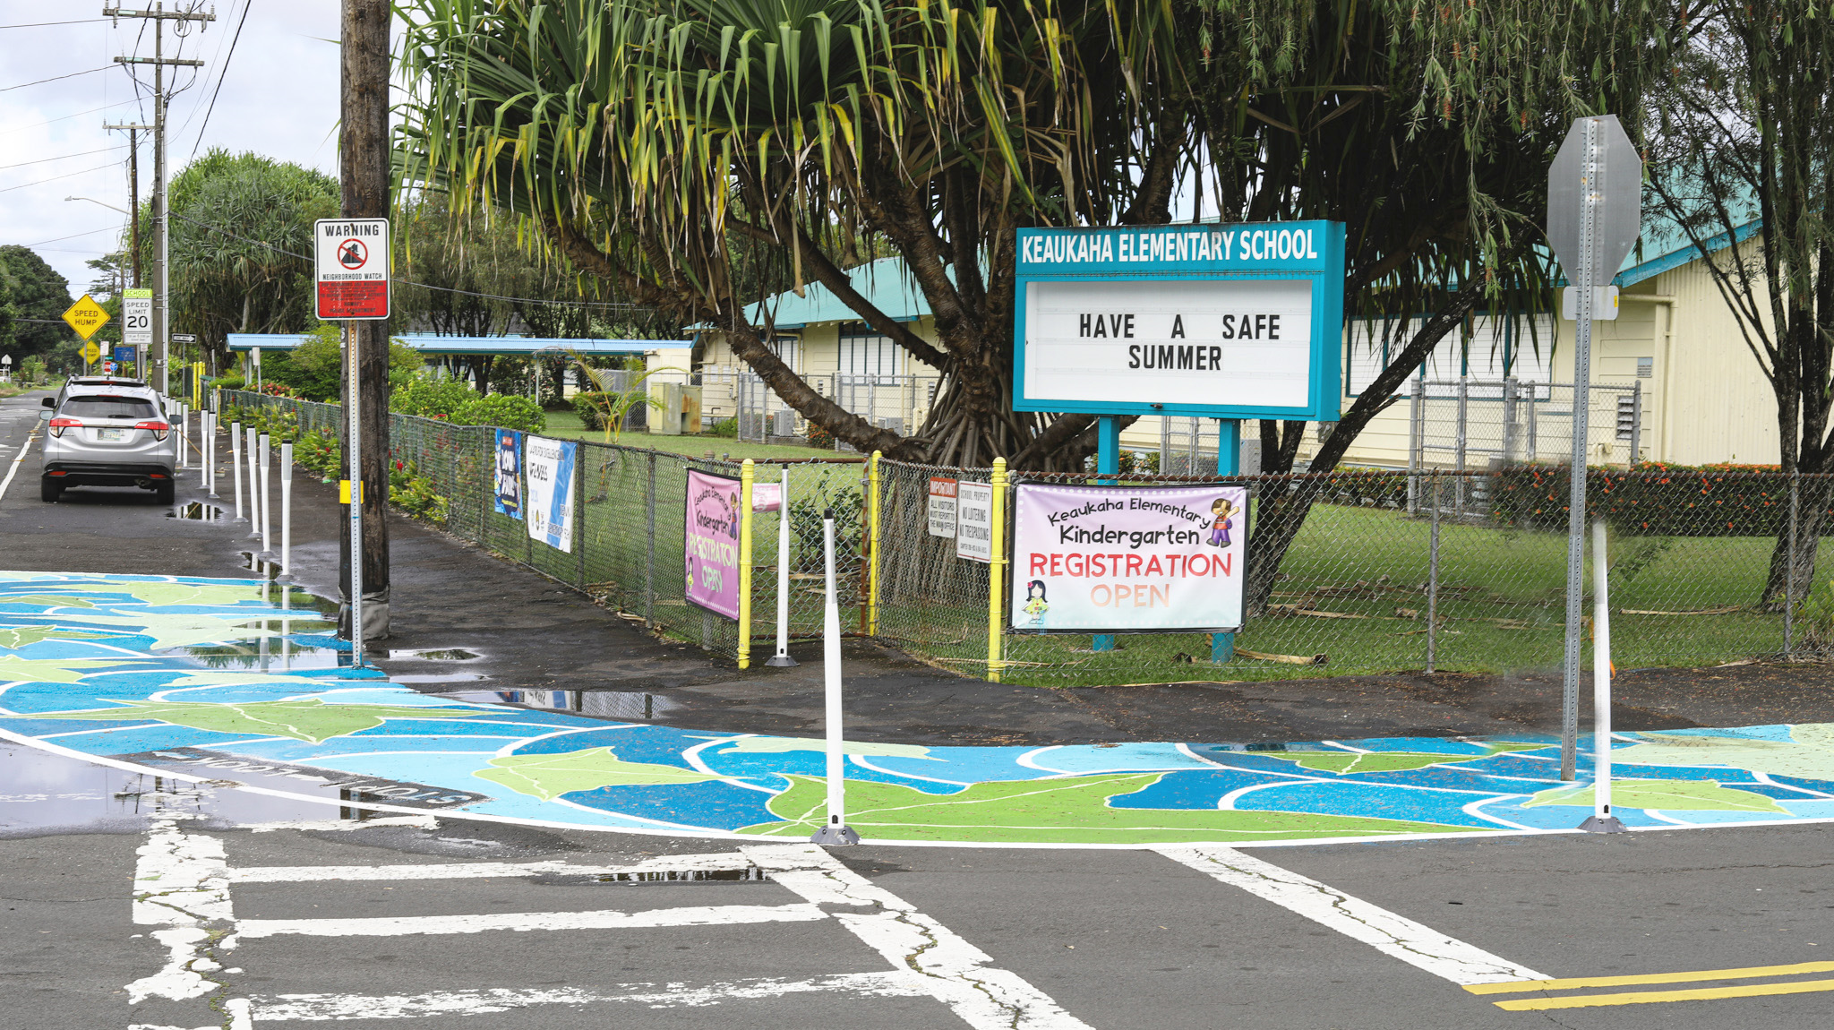
Keaukaha Quick Build Project

Slide 8
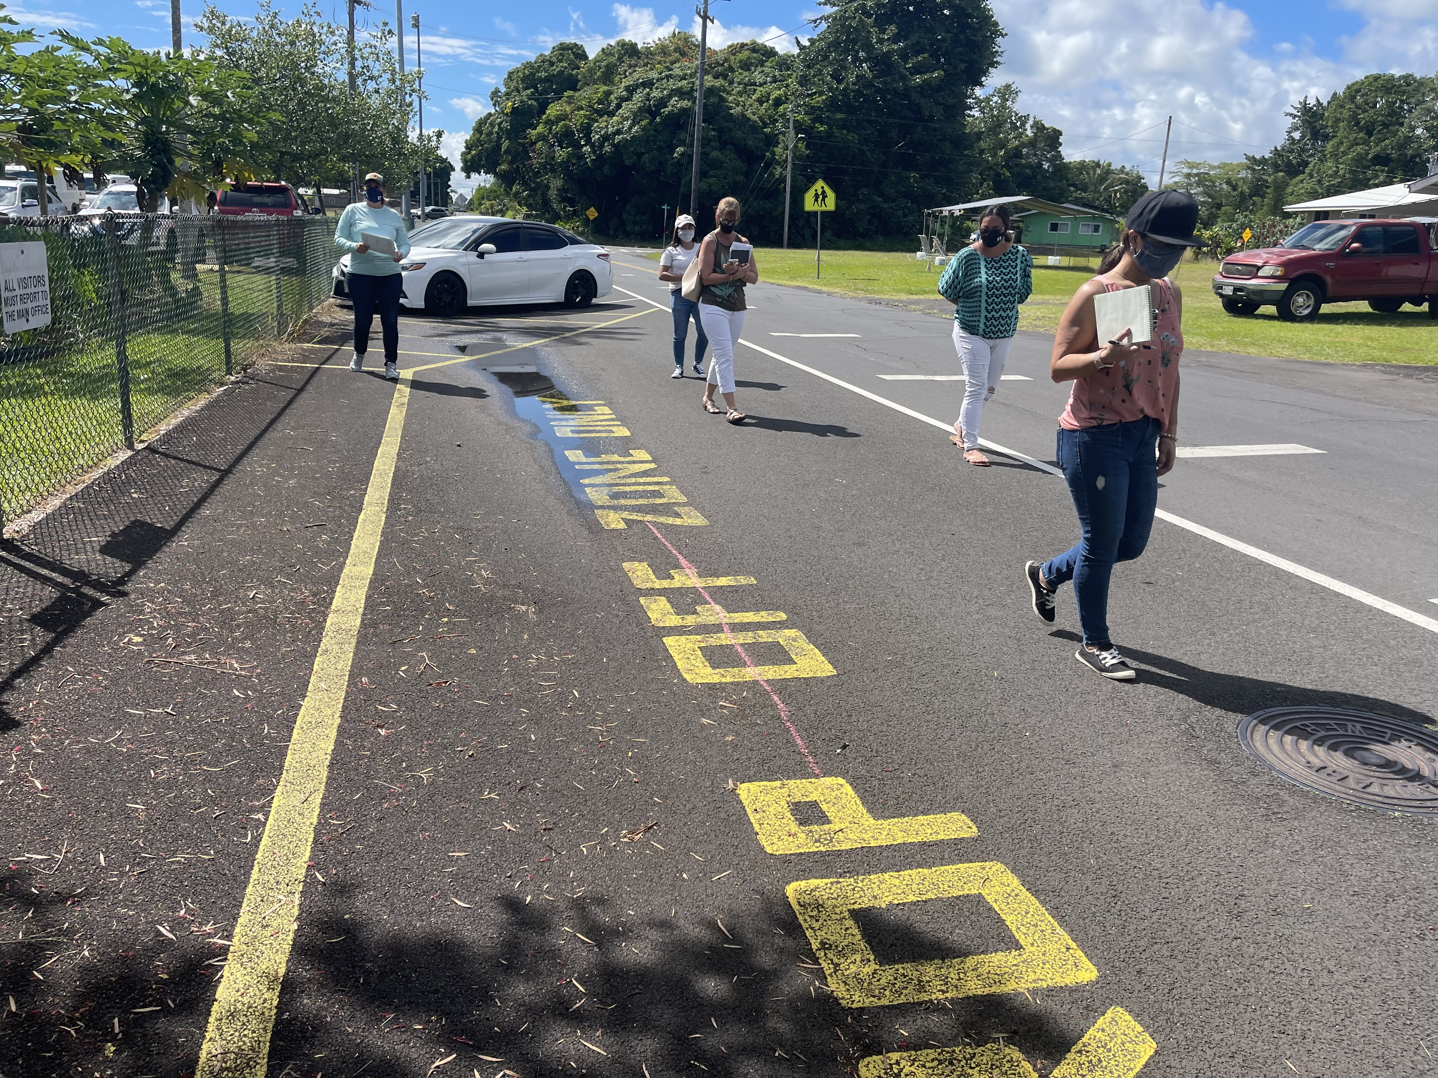
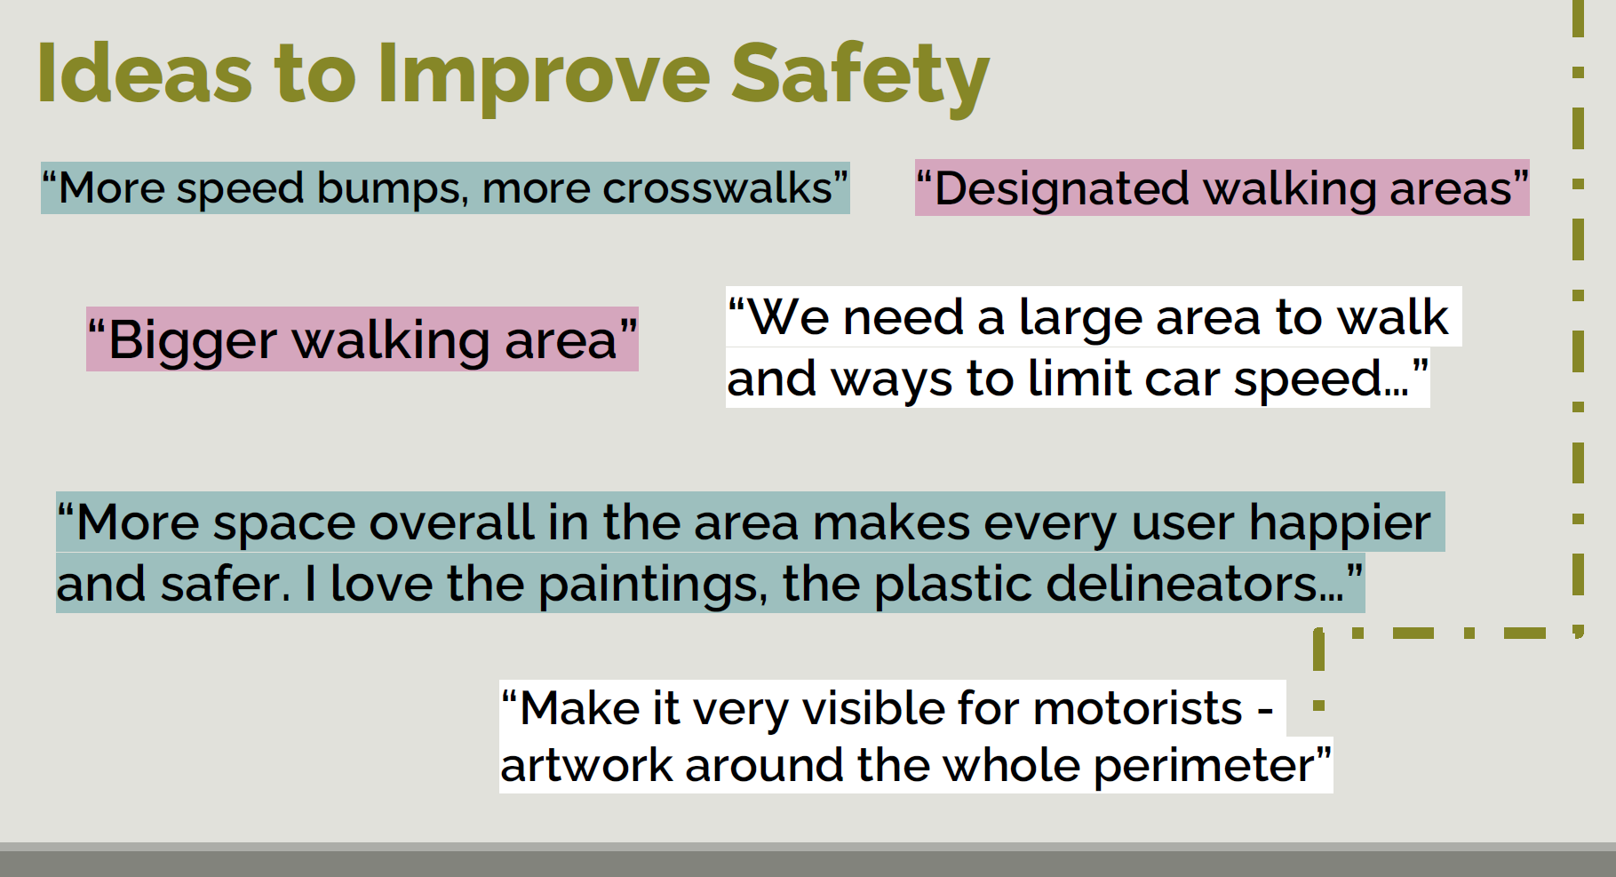

Slide 9
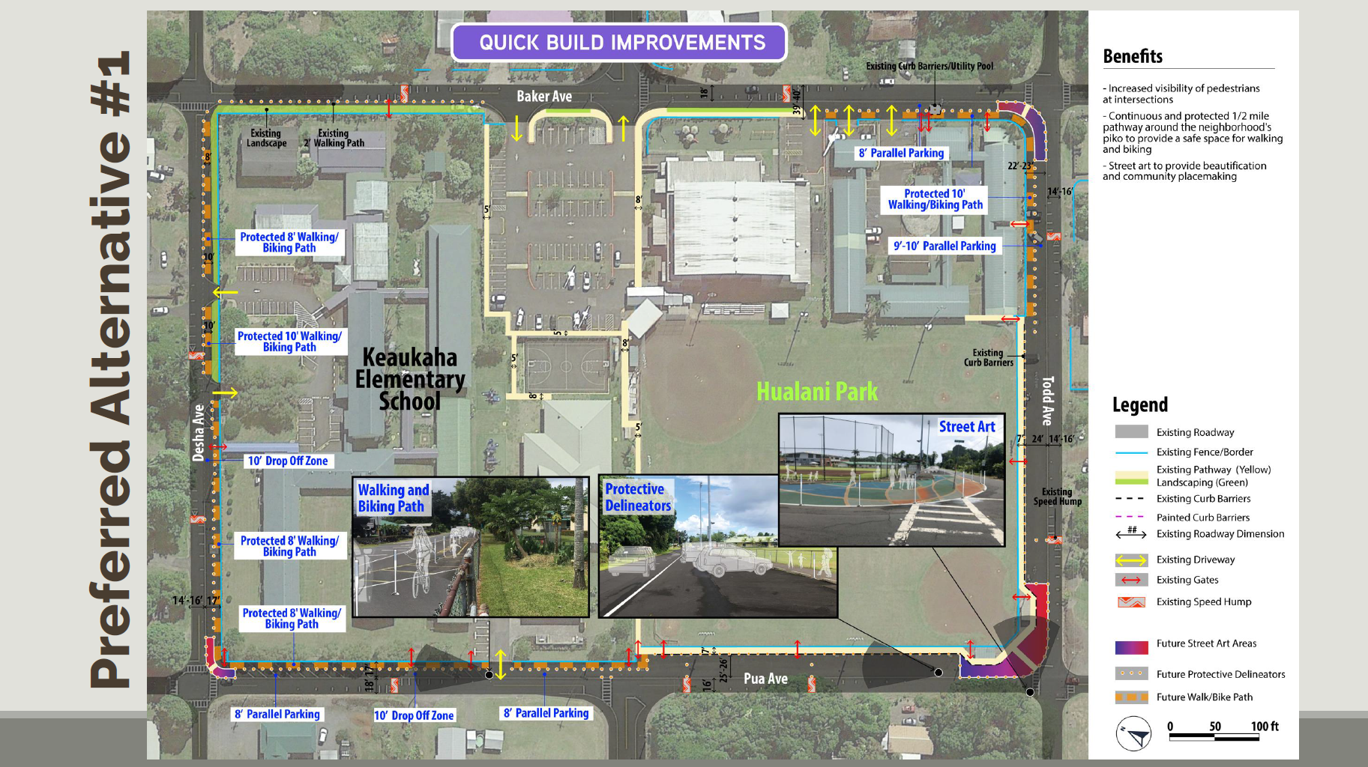

Slide 10
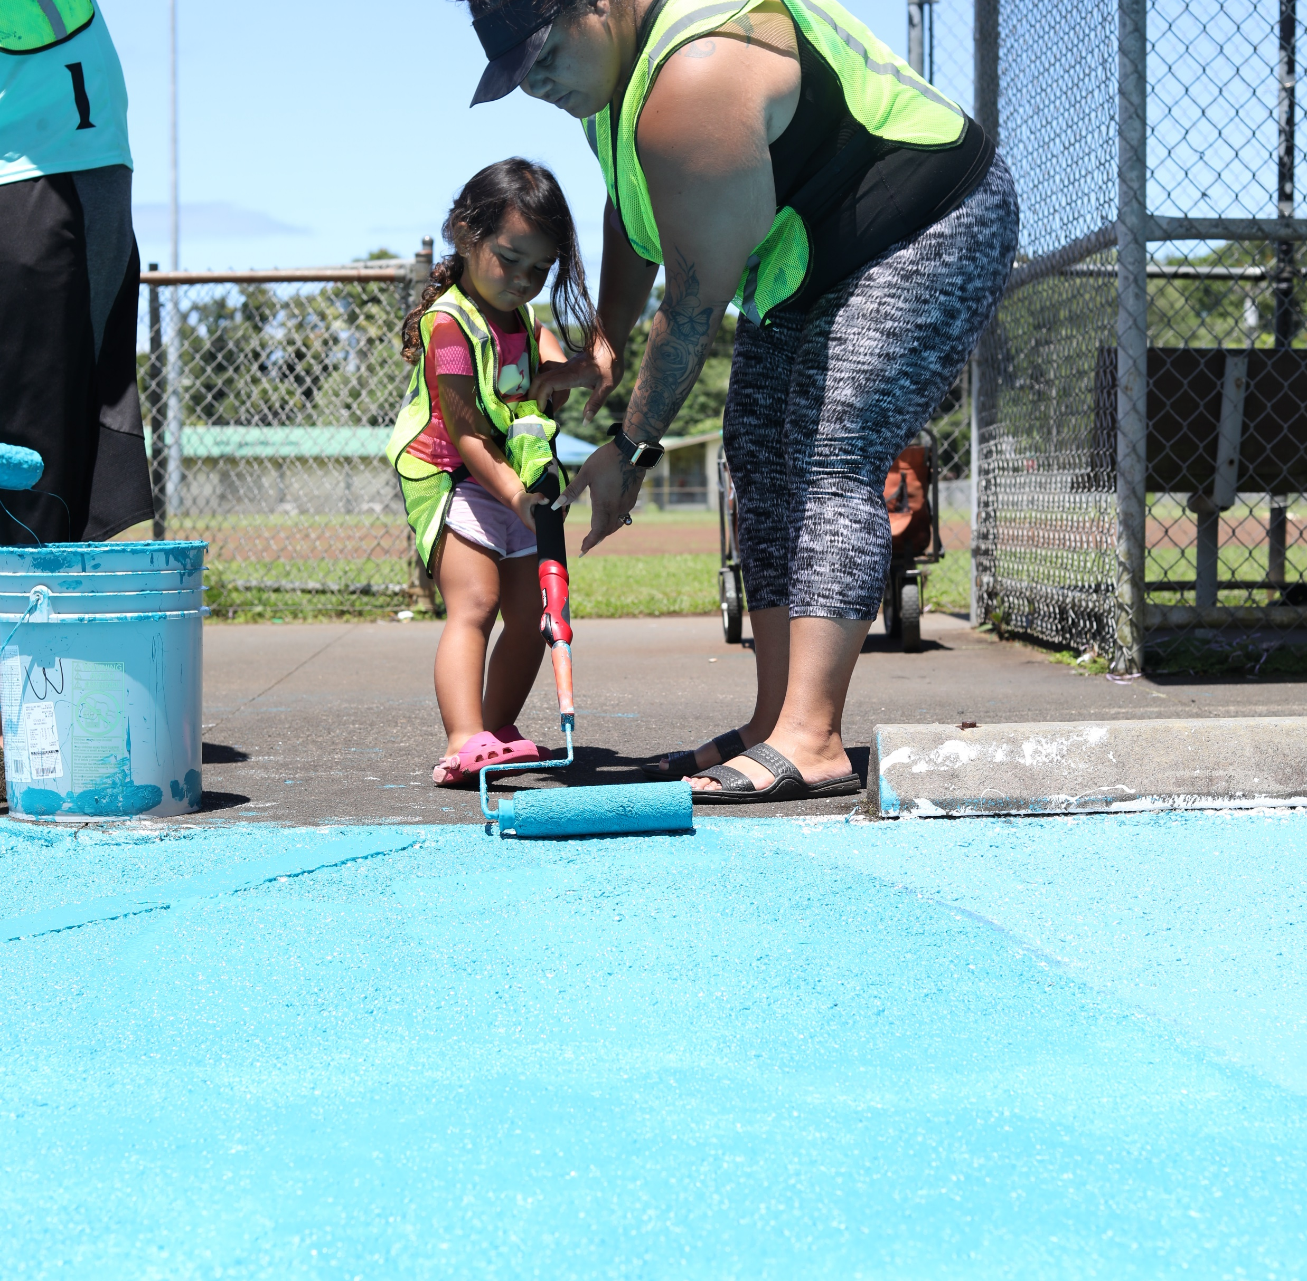
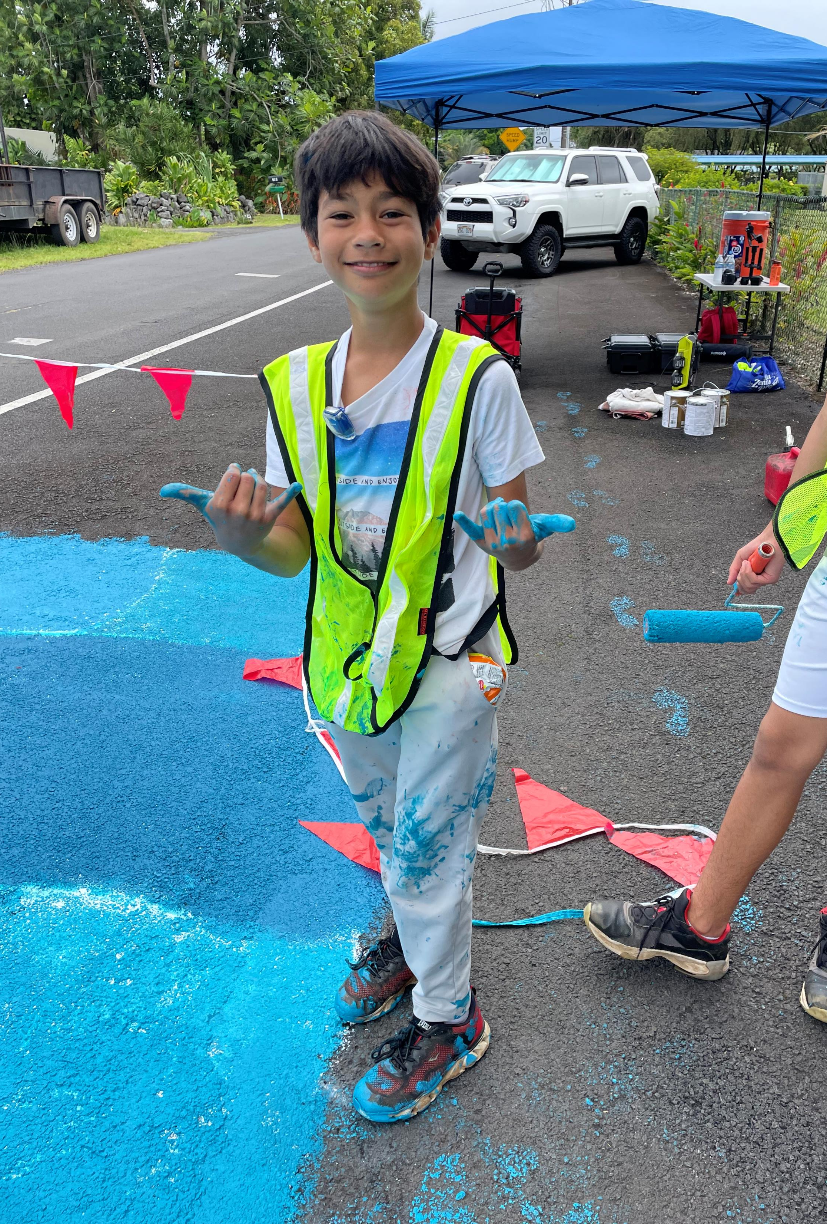
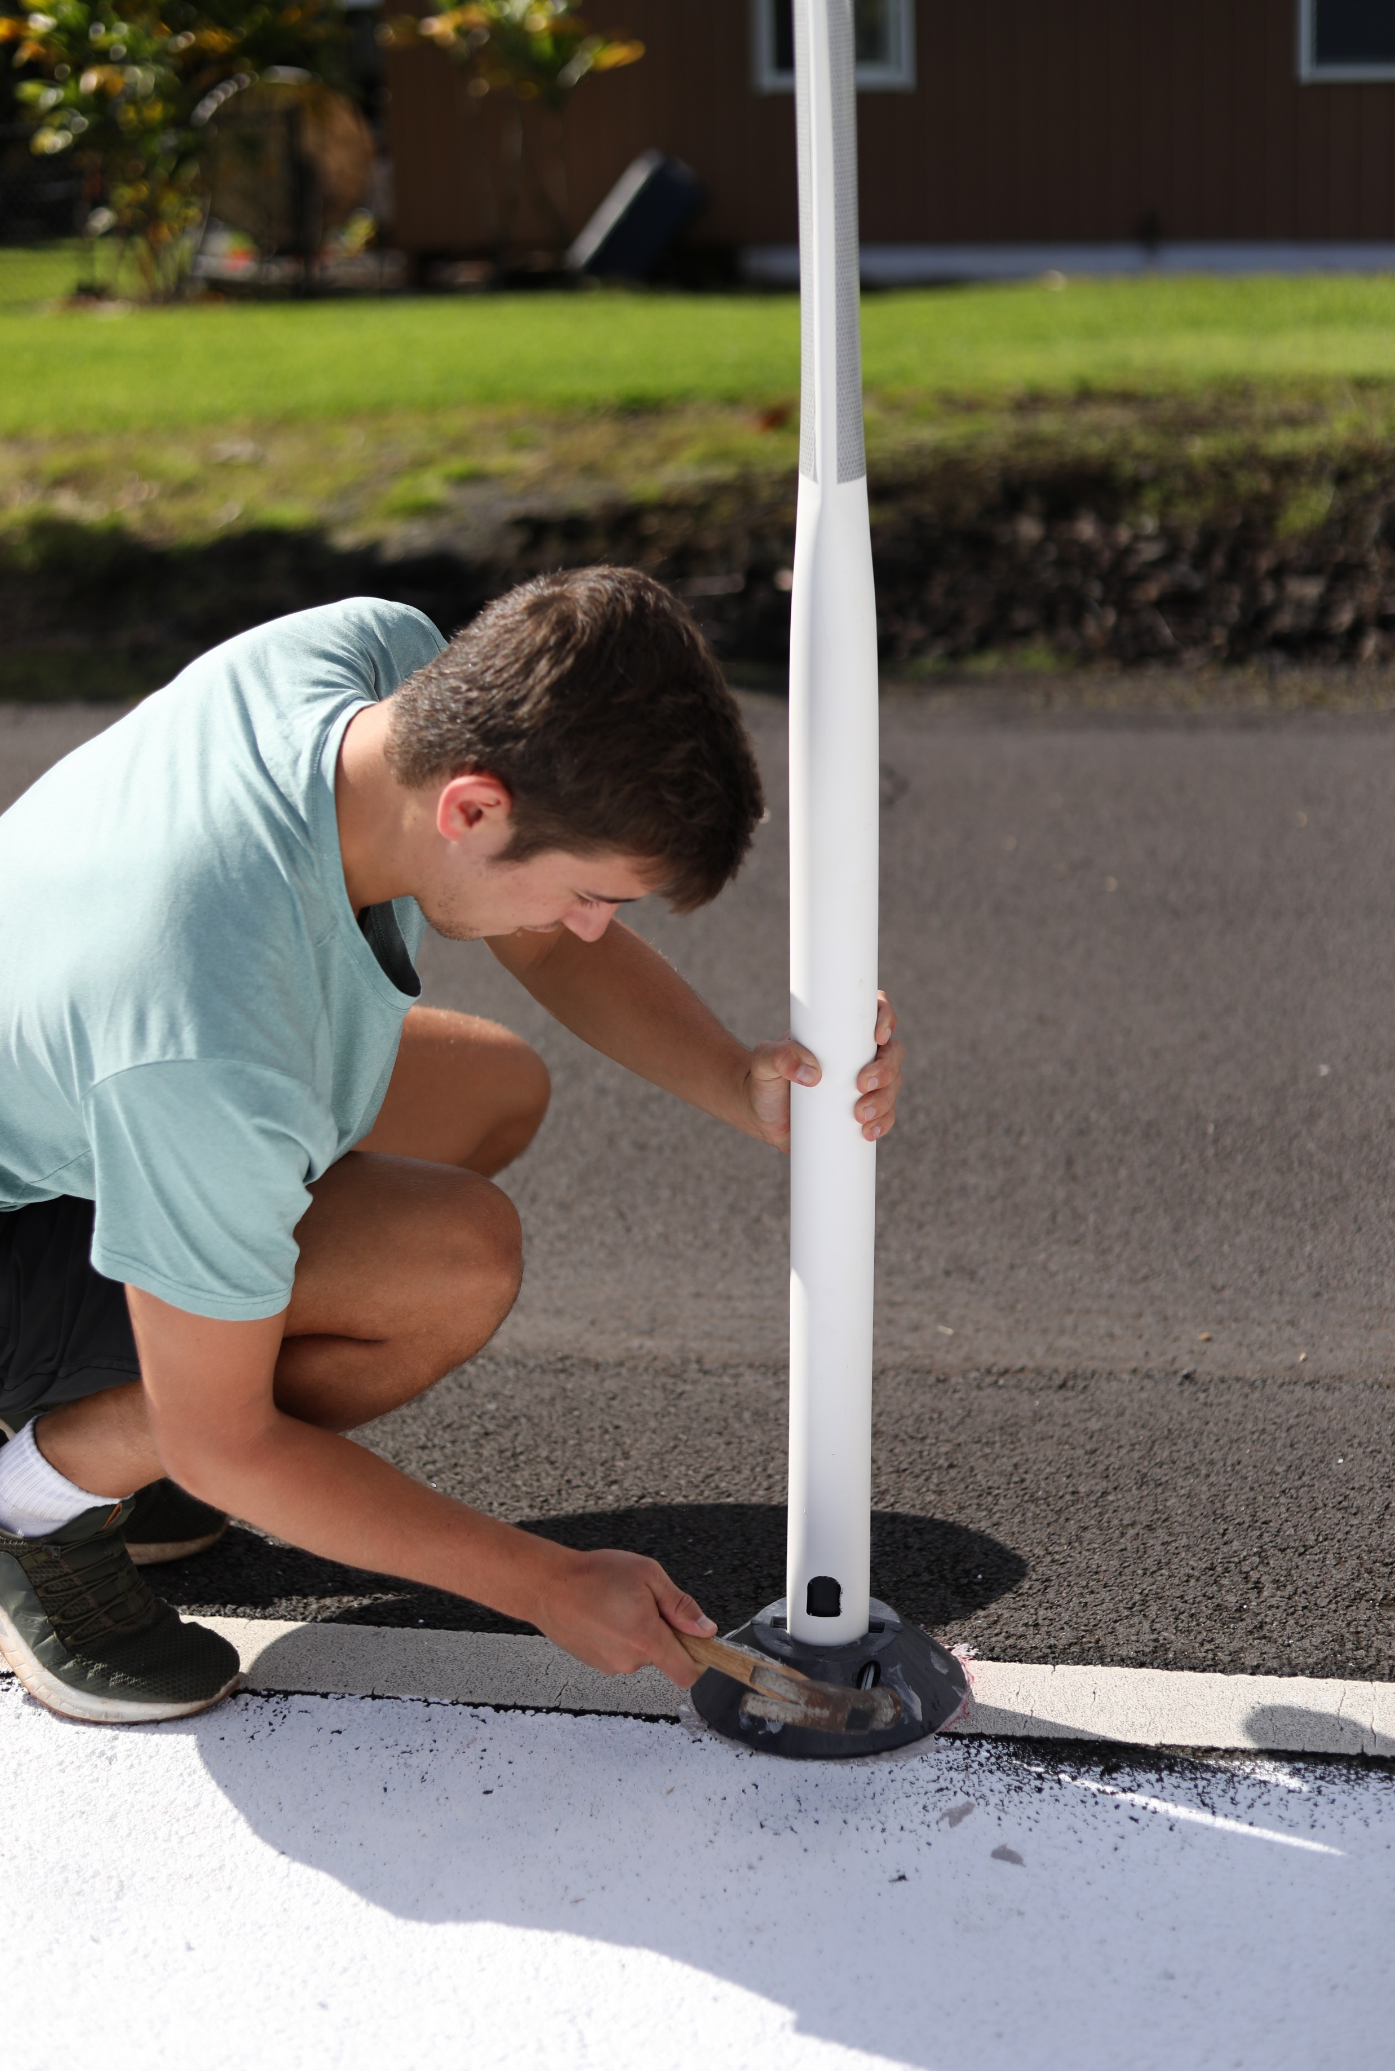
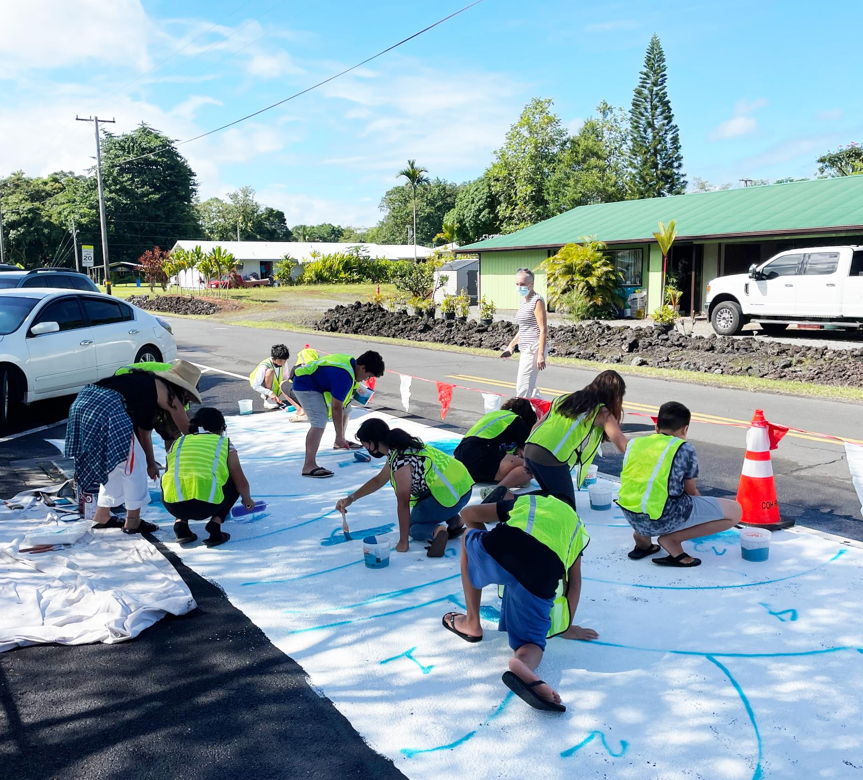

Slide 11
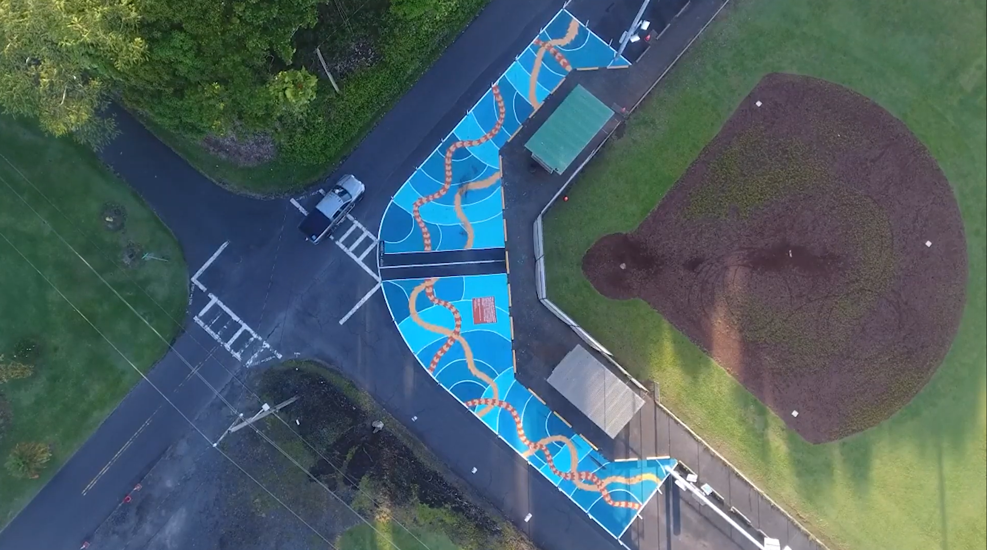

Slide 12
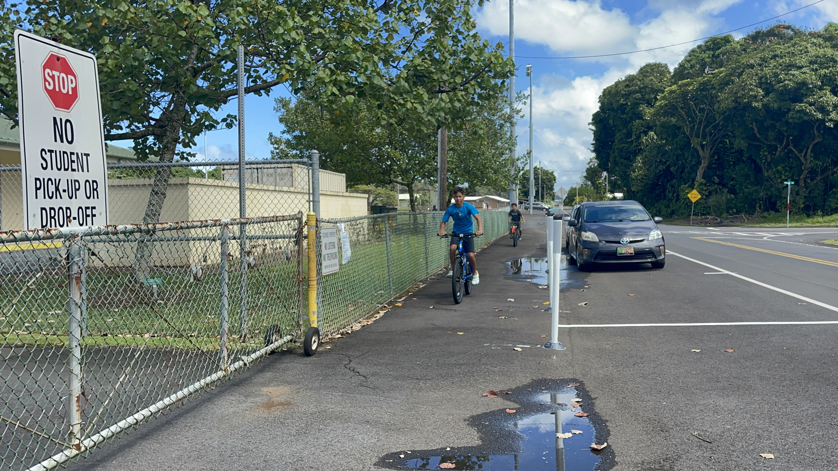

Slide 13
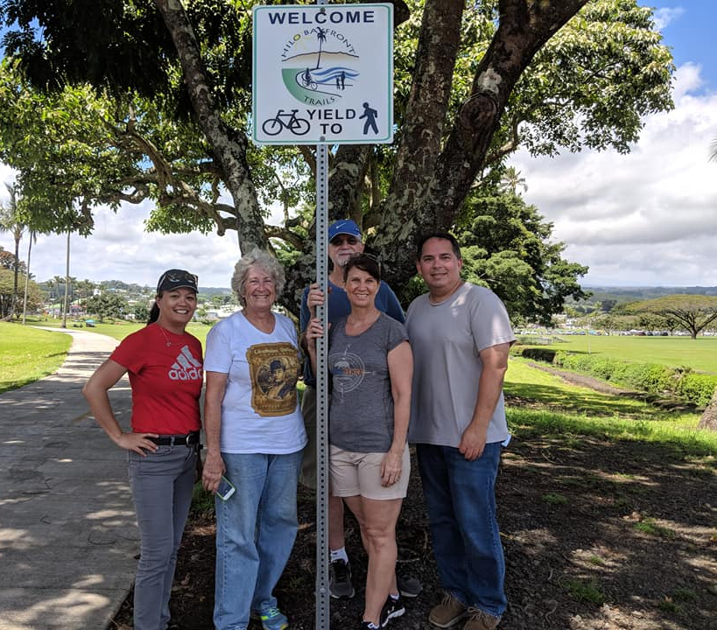
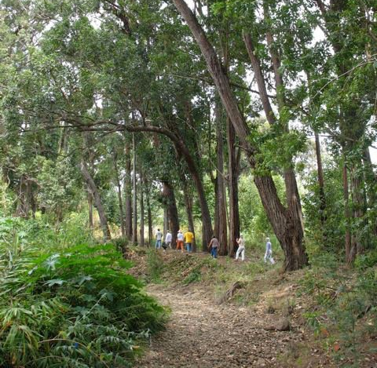
Hilo Bayfront Trails
Waimea Trails and Greenway

Slide 14
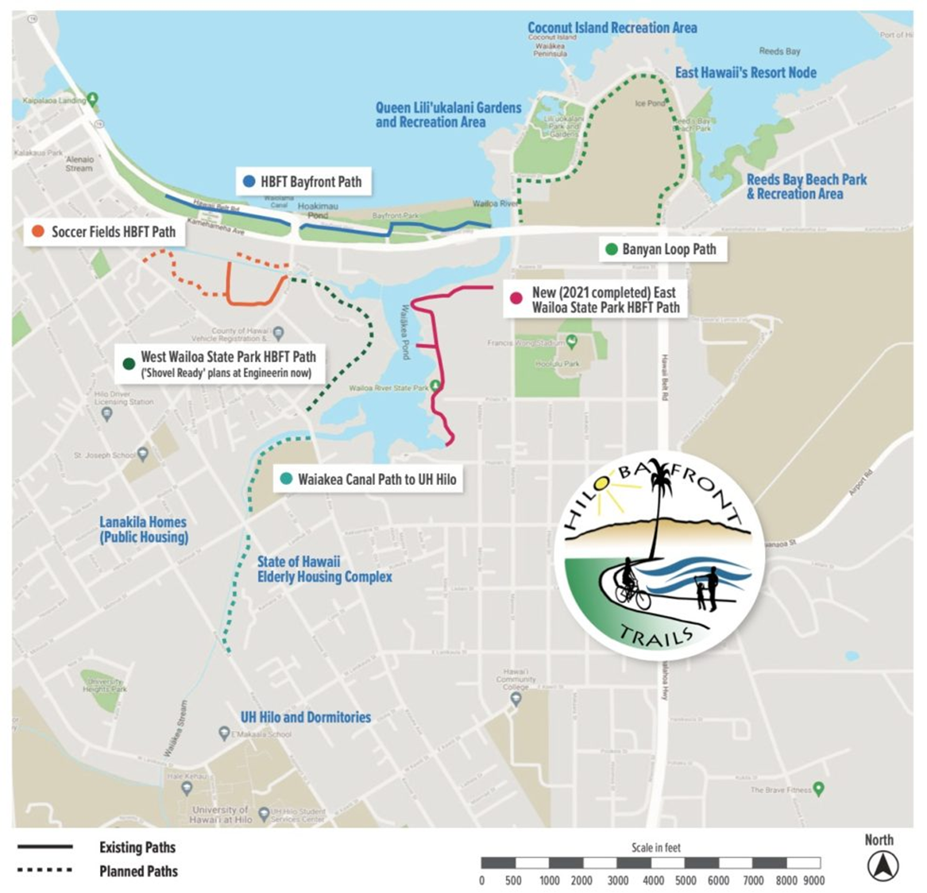
Hilo Bayfront Trails
2010 –Planning commenced
2016 - Phase I Complete
2021 Wailoa State Park Section Complete
2022Phase IIA completed
2023 Phase IIB to start construction
TBD Bayan Drive and Waiakea Flood Chanel sections

Slide 16
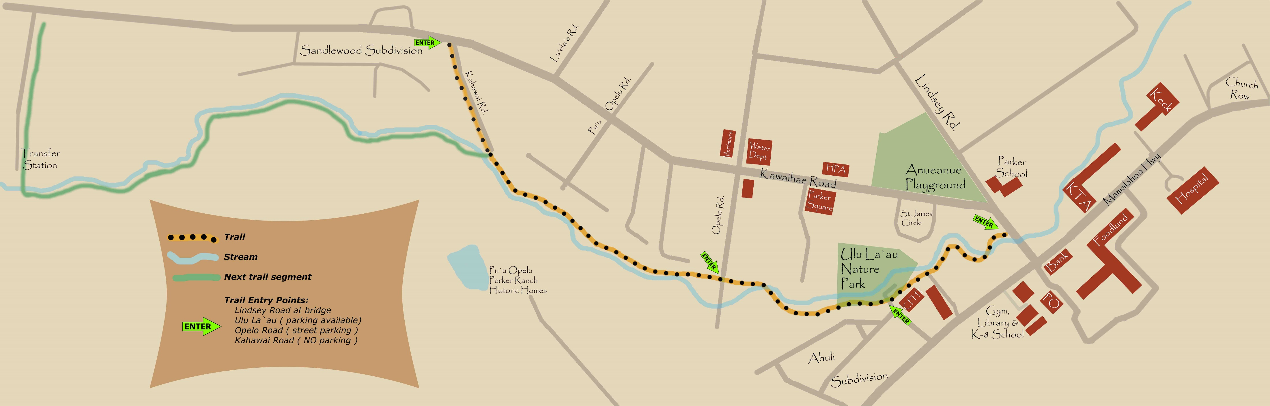
Waimea Trails Phase 1
1994-2000 master planning of trail complete with
4 mile long trail along the Waikoloa Stream to be completed in 4 phases
2000 – to present, volunteers have cleared and maintained a dirt trail through current County easements
Currently in design to pave the first mile of the trail Phase 1, a section from Kahawai Street to Lindsey Road
  Goals to increase accessibility and make ADA compliant
  working on RAISE grant application for 2023 construction estimated at $8M

Slide 17
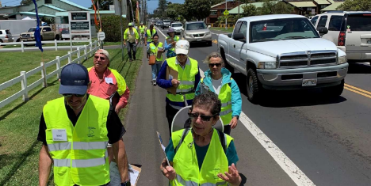
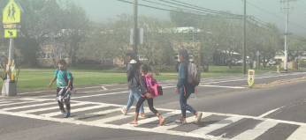
Active Transportation in Waimea Challenges
No sidewalks along Kawaiahe Rd and Mamalahoa Hwy
400 conflict points along these roadways including intersection and driveways
Close proximity to cars while walking and biking are uncomfortable/undesirable

Slide 18
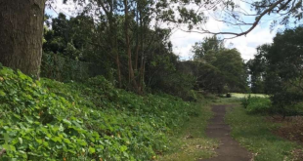
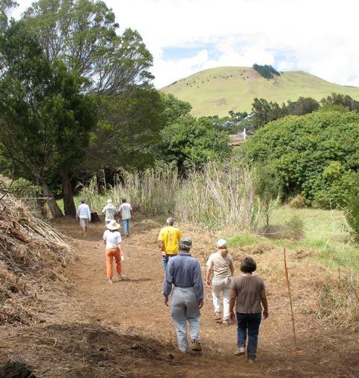
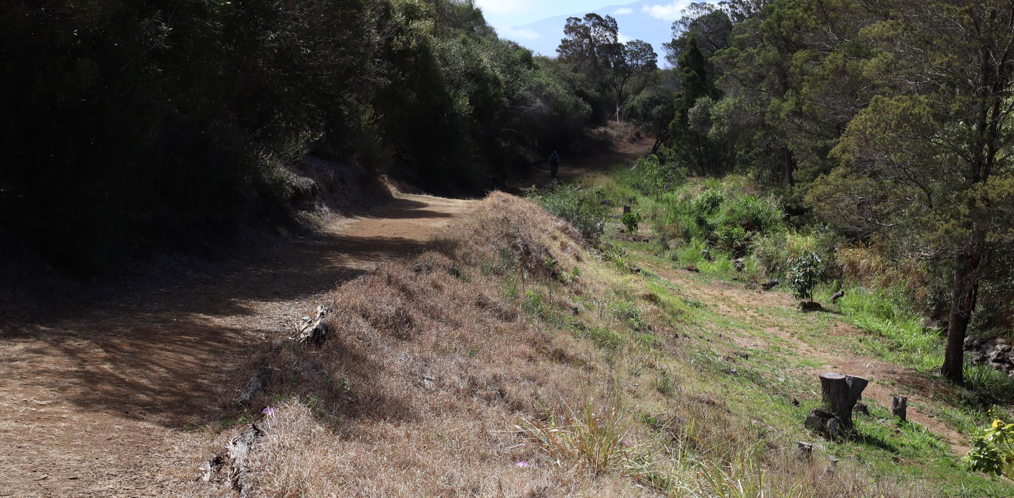

Slide 19
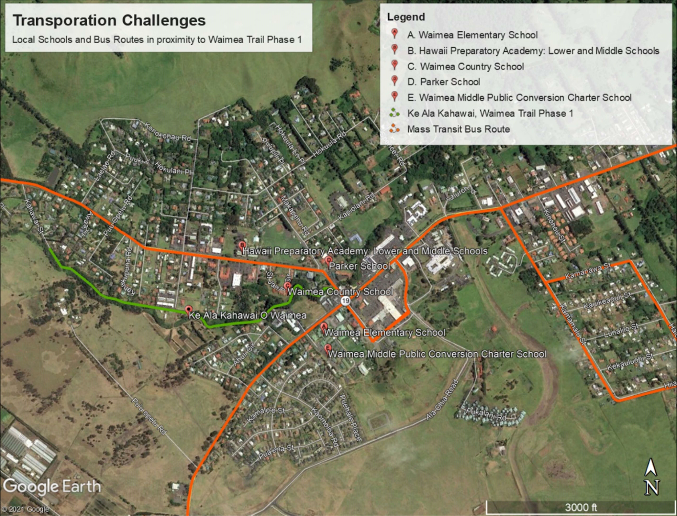

Slide 20
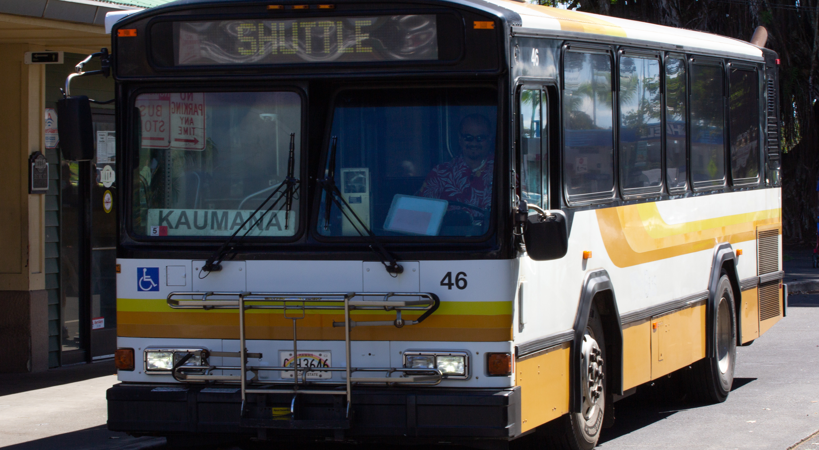

Pan 08 The state and each county will identify and adopt mode-share goals and measurements that prioritize walking and wheelchairs, bicycling, and transit use.
Pan 09 Increase by 10%, the proportion of existing urbanized land zoned to support walkable communities.

Slide 21
The Transit and Multi-Modal Transportation Master Plan
Completed in August 2018
Updated in August 2022
Links public transit to multi-modal transportation
Rebuilds the transit system
Financial sustainable path
Economic development
Expands routes and services
Restores ridership
Implements new modes such as bikeshare, microtransit, TNC partnerships, and specialized demand response services.

Slide 22



The Bus and Bike is Free!
Going fare free for to grow ridership and restore creditability
All Hele-On fixed route and paratransit services are fare free.
Re-creation of a similar service that was fare free from 2005 to 2013.
Passenger trips grew from 329,000 to over 1.2 million during this time frame.
Connect people to opportunity and addresses social equity.
HIBIKE is also free for Hele-On users.
Ridership is growing systemwide as a result.

Slide 23
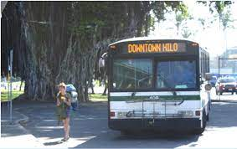
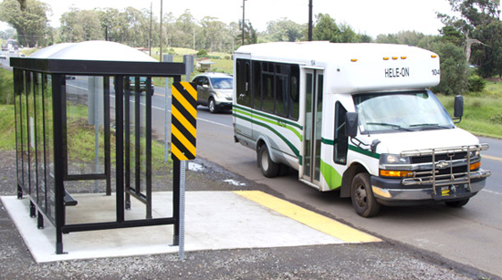
Hele-On Family of Services
Multi-Modal Opportunities Across the Island
Fixed Route
Flex Route
Shared Ride
(Taxi + Uber)
Paratransit
Vanpool
Microtransit
Bikesharing
Door to Door Rural Services
Carpooling

Slide 24
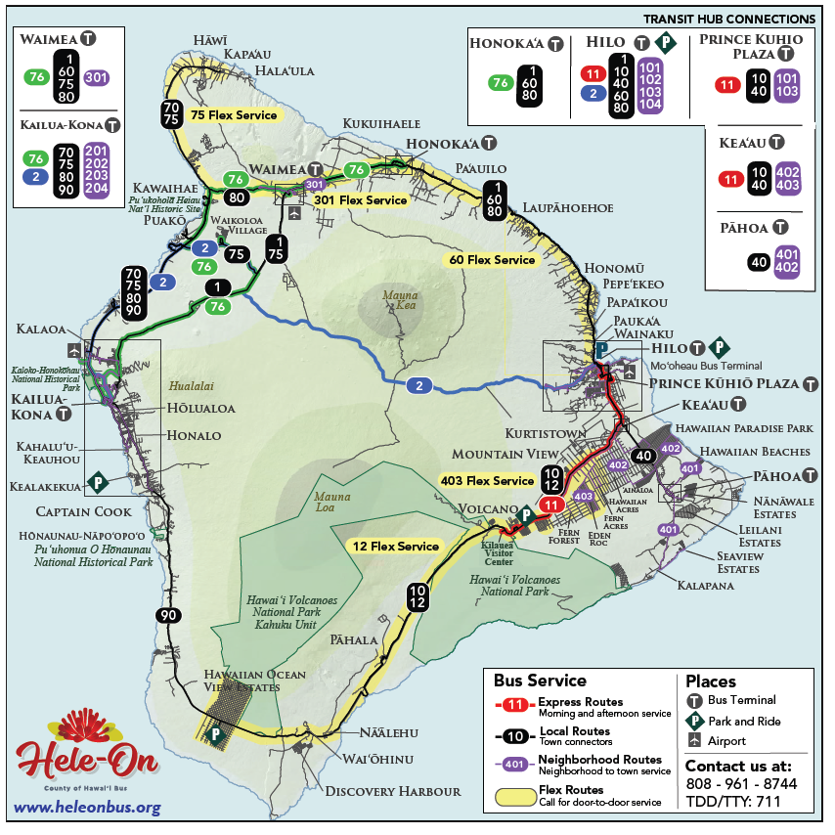
The Network
24 routes to connect people across the island and between communities.
Service rolling from 3:15 a.m. to 2:15 a.m., seven days a week.
Every community on the island has a bus seven days a week.
Door to door flex services available on five routes.
Park and ride lot opportunities across the island.
More connectivity island-wide.

Slide 25
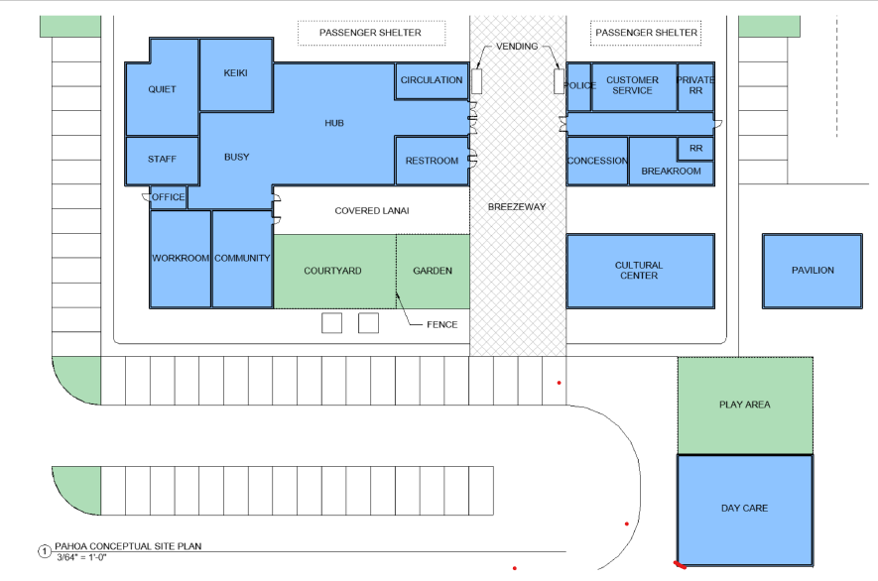
Pahoa Transit Hub and the Pahoa Library
Co-Location with Pāhoa State Library
Expand Bike Share to Pāhoa
Other amenities
  Daycare
  Cultural Pavilion
  Community Garden
  Goodwill Drop off
Notes:
Part of the Mass Transit and Multimodal Master Plan to move to a hub and link service
Conceptual design

